Slide 1
IPL 2020 Cricket Match Analysis Project
Presented By:
Harish V
PGddm49
DATA SCIENCE and MACHINE LEARNING

Slide 2
Presentation Map
Introduction to IPL 2020 Cricket Match Analysis
Objectives
Data Overview
Dataset
Using Library For the Data Analysis
Using Functions For the Data Analysis
Data Cleaning Process
Data Visualization Examples
Conclusion

Slide 3
Introduction to IPL 2020 Cricket Match Analysis
This analysis aims to provide insights into the team performances, individual brilliance, match statistics, and key turning points throughout the season. From Mumbai Indians' dominant title run to the unexpected struggles of perennial contenders like Chennai Super Kings, IPL 2020 featured a rollercoaster of emotions and game-changing moments.
Data Source:
Daily_matchdata.csv
Fantasy_points_Dream11.csv
IPLMatchResults2020.csv

Slide 4
Objectives:
Data Overview and Basic Statistics
Which team won the most matches Analysis
Toss decision impact on result Analysis
Average 1st innings score per ground Analysis
Top 5 players by total Dream11 points Analysis
Correlation between Age and Performance Analysis
Average points by Role Analysis
Runs distribution: Chasing vs Defending
Top 10 Individual Performances
RH vs LH Average Dream11 Points
Visualization:
Pivot Table

Slide 5
Data Overview and Basic Statistics
What is the size of the dataset (number of rows and columns)?
What are the data types of each column?
Are there any missing values in the dataset?

Slide 6
Data Cleaning Process
Reading the Data
Understanding the Data/ Getting some domain knowledge on Data
Replacing junk Values using NaN values
converting each and every column to its respective dataType
Replacing NaN values with some meaningful values
Droping unwanted columns, duplicated columns and duplicated rows
Saving the pure/cleaned dataset in the desirable format

Slide 7
Using Library For the Data Analysis
1. NumPy: Import NumPy because it provides the
fundamental array and numerical computing
functionalities that are used by other libraries.
2. Pandas: After NumPy, am import Pandas because
it builds on NumPy and provides data structures for
data manipulation and analysis.
3. Matplotlib: It is used for the Visualization. It's a
versatile library for generating various types of plots.
4. Seaborn: Seaborn is used to visual the complex
statistical visualizations .Seaborn is built on top of
Matplotlib and simplifies the process of creating
informative visualizations.

Slide 8
Using Functions For the Data Analysis
Value_Count
Groupby
Crosstab
lambda
And some other inbuild functions

Slide 9
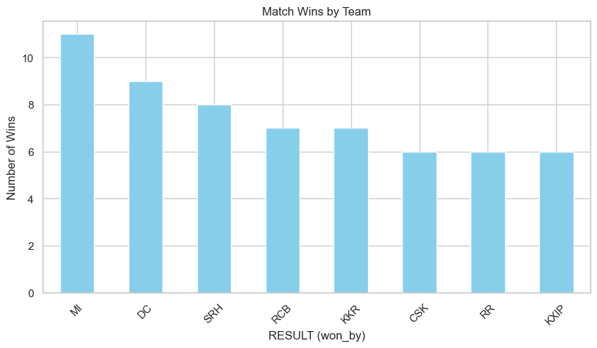
Which team won the most matches in IPL 2020
ipl['RESULT (won_by)'].value_counts().plot(kind='bar', color='skyblue')
plt.title("Match Wins by Team")
plt.ylabel("Number of Wins")
plt.xticks(rotation=45)

Slide 10
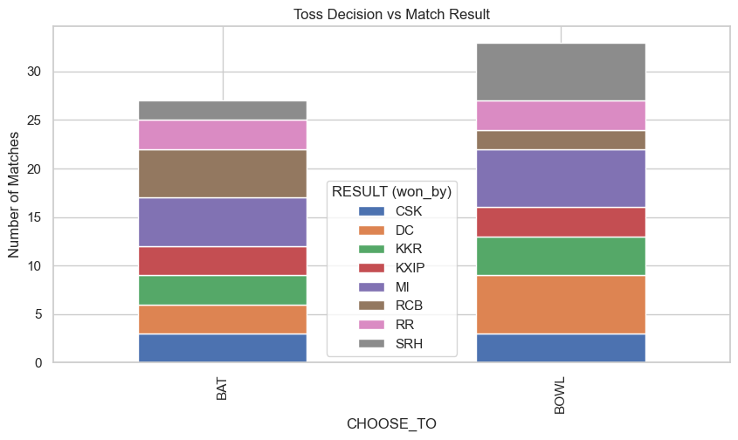
How does toss decision (BAT vs BOWL) affect match outcomes
pd.crosstab(ipl['CHOOSE_TO'], ipl['RESULT (won_by)']).plot(kind='bar', stacked=True)
plt.title("Toss Decision vs Match Result")
plt.ylabel("Number of Matches")

Slide 11
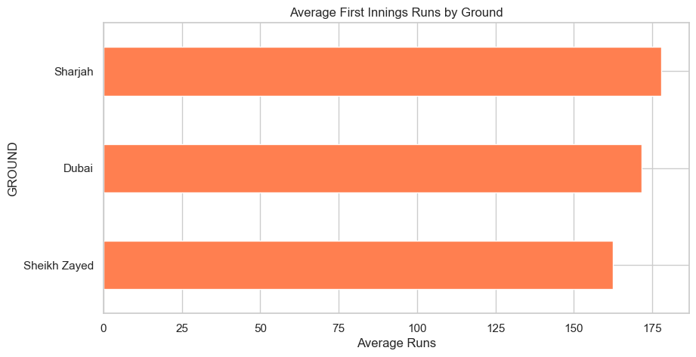
Which grounds saw the highest average first innings scores
ipl['First_half_runs'] = ipl['First_half_score'].str.extract(r'(\d+)').astype(float)
ipl.groupby('GROUND')['First_half_runs'].mean().sort_values().plot(kind='barh', color='coral')
plt.title("Average First Innings Runs by Ground")
plt.xlabel("Average Runs")

Slide 12
Which players scored the most total Dream11 points across all matches
# Clean and convert
match_cols = [c for c in fantasy.columns if c.startswith("Match_")]
fantasy[match_cols] = fantasy[match_cols].applymap(lambda x: str(x).strip().replace("DNP", "0").replace("DNB", "0"))
fantasy[match_cols] = fantasy[match_cols].astype(float)
fantasy["Total_Points"] = fantasy[match_cols].sum(axis=1)
# Top players
top_players = fantasy.sort_values("Total_Points", ascending=False).head(5)
sns.barplot(data=top_players, x="Total_Points", y="Player", palette="viridis")
plt.title("Top 5 Players by Total Dream11 Points")

Slide 13
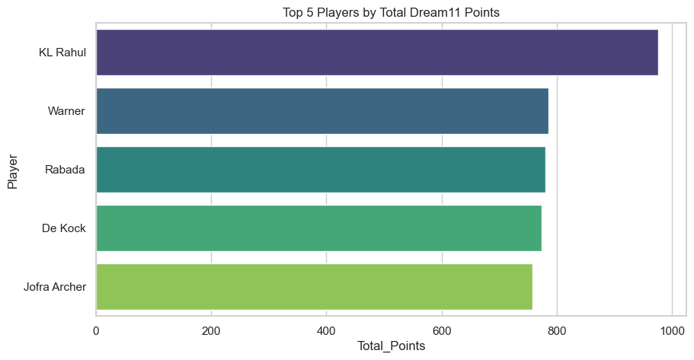

Slide 14
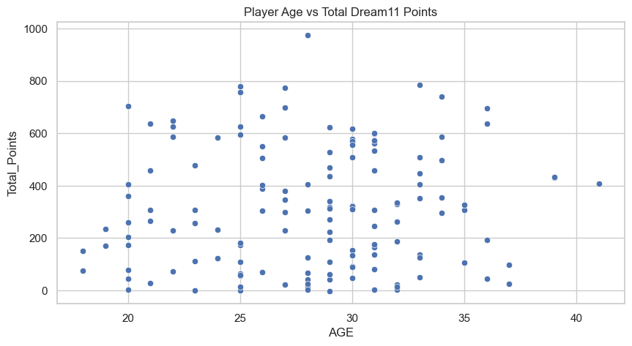
Is there a correlation between player age and their fantasy performance
sns.scatterplot(data=fantasy, x="AGE", y="Total_Points")
plt.title("Player Age vs Total Dream11 Points")
plt.show()
# Correlation
fantasy[['AGE', 'Total_Points']].corr()

Slide 15
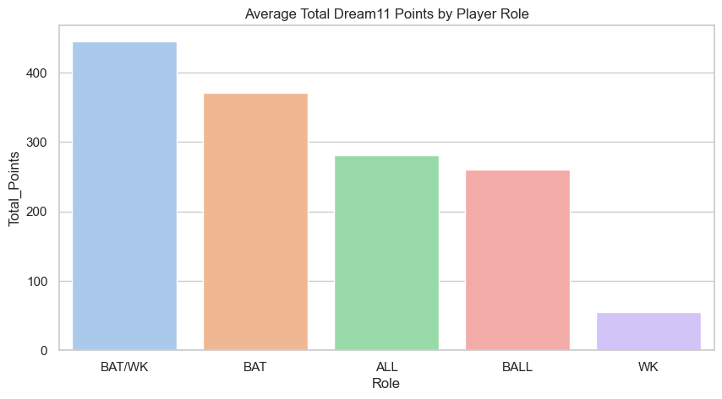
Compare average points by player roles (BAT, BOW, AR, WK)
sns.barplot(data=fantasy, x="Role", y="Total_Points", estimator='mean', ci=None, palette="pastel")
plt.title("Average Total Dream11 Points by Player Role")

Slide 16
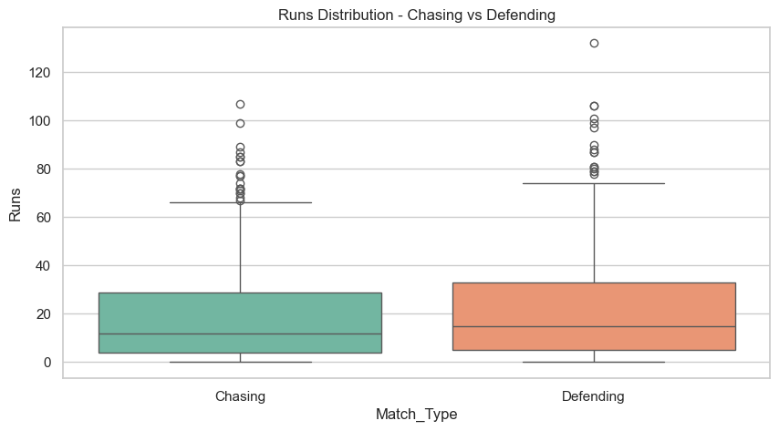
What’s the distribution of runs scored by players in each match type (Chasing vs Defending)
daily["Runs"] = pd.to_numeric(daily["Runs"], errors="coerce")
sns.boxplot(data=daily, x="Match_Type", y="Runs", palette="Set2")
plt.title("Runs Distribution - Chasing vs Defending")

Slide 17
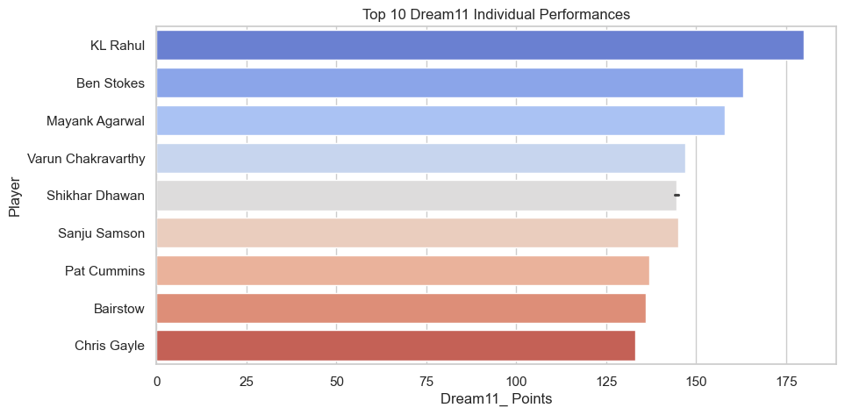
Top 10 individual performances by Dream11 points.
daily["Dream11_ Points"] = pd.to_numeric(daily["Dream11_ Points"], errors="coerce")
top_performances = daily.sort_values("Dream11_ Points", ascending=False).head(10)
sns.barplot(data=top_performances, x="Dream11_ Points", y="Player", palette="coolwarm")
plt.title("Top 10 Dream11 Individual Performances")

Slide 18
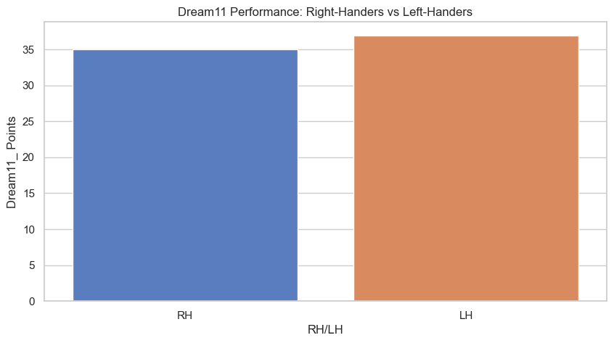
Compare Dream11 performance for right-handers vs left-handers
sns.barplot(data=daily, x="RH/LH", y="Dream11_ Points", estimator='mean', ci=None, palette="muted")
plt.title("Dream11 Performance: Right-Handers vs Left-Handers")

